Slide 1

The Industry’s Best Kept Secret:
Surgical Danger and the
New Technological Solution
Presenter name and date

Slide 2
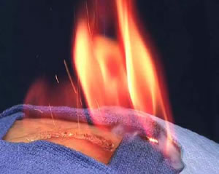
Surgical Fires are the FDA and AORN*
#1 Surgical Safety Priority¹
Notes:
FDA = Food and Drug Administration
AORN = Association for Perioperative Nurses, non-profit membership association representing the interests of more than 160,000 perioperative nurses by providing nursing education, standards, and clinical practice resources. AORN also defines and advances best nursing practices for surgical patients by researching and distributing scientifically based guidelines.²

Slide 3
Surging Incidence of Surgical Fires
Despite surgeons and OR team following fire prevention protocols, increasing surgical procedures^{3,4} causes more surgical fires worldwide^{3,5-8}
ESU’s⁹ and common OR practices largely to blame^{8,10-11}
Current preventative measures ineffective^{5,10}
Notes:
ESU = Electrosurgical Unit, referring to ESU, cautery, laser, etc. using electricity to causer thermal tissue destruction for dehydration, coagulation or vaporization. Electrosurgical units also referred to as diathermy, energy based devices and different than cautery (passive heat transfer).⁹
*Often electrosurgical devices, including electrocautery, are used interchangeably. Although distinct, every effort is made in the presentation to distinguish electrocautery devices from high-frequency electrosurgery, wherever, distinct mention has been made to electrocautery. Despite this, both have been noted in recent literature to be ignition sources in 90% of OR fires.

Slide 4
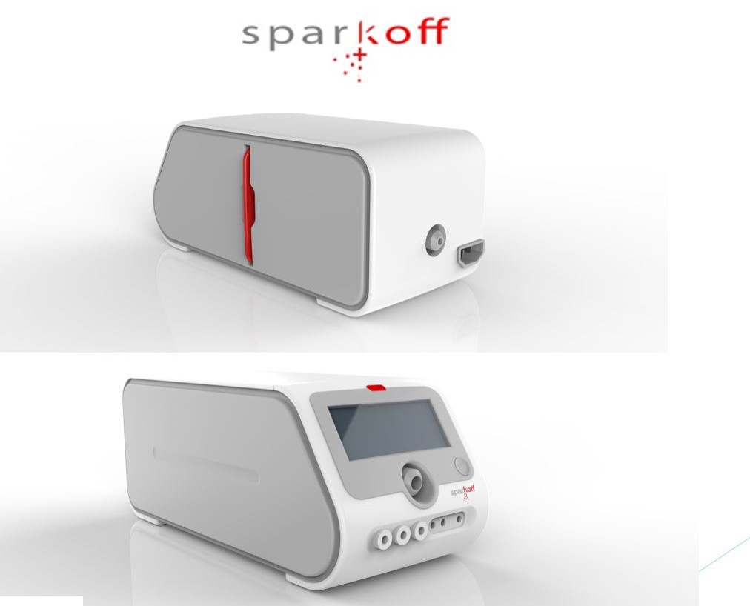
Introducing Sparkoff – A Modern Solution to Surgical Fires
Only market ready, 510K-approved surgical device with MEMS that detect gas, automatically cuts power and auto-powers on after fire threat.
Notes:
Sparkoff effectively creates a new, better firewall to OR fires.

Slide 5
Dramatic Rise in Surgical Volume
Increases Overall Fire Risk
United States
In 2008, 50 million+ in- and outpatient surgeries performed in U.S./year¹²⁻¹³
By 2014, 125.7 million outpatient surgeries/year¹⁴, over double 2008’s total surgeries
Globally
In 2012, approx. 312.9 million surgeries/year, up 38.2% from 2004¹⁵
4,469 surgeries/100,000 people (mean estimate)¹⁵
  Minimally Invasive/Interventional Surgeries Preferred, Global CAGR¹⁶, 10.5% from 2013-2019, $50.6 billion value by 2019¹⁷
Notes:
Additional Minimally Invasive Notes for 2012 bullet:¹⁷
Ablation devices used to treat most cancers, a huge worldwide market
These devices also used in surging cosmetic surgery market
CAGR = Compound Annual Growth Rate, the mean annual growth rate of an investment over a specified period of time longer than one year.¹⁶

Slide 6
ESU/Electrocautery’s Far Reaching Prevalence
Used in every OR^{8,18} and almost ALL interventional procedures today⁸
  $4.48 billion Global ESU market in 2015³
  ESU market to top $7.9 billion by 2024, up 76%³
  Radiofrequency ESUs growing rapidly³
    In 2015, $923.6 million value in U.S., 53% global ESU market share³
    No end in sight to ESU growth.¹⁹
Notes:
Used in al surgical procedures today: open, laproscopic, robotic and endoscopic⁸

Slide 7
Surgical Fire Incidents on the Rise
United States
550-650 ”reported” surgical fires/year (FDA)^{12,20-21}
  >30% harm the patient¹
  >20% serious or disfiguring burns with other associated morbidity^{12,22,10}
  1-2 deaths/year^{12,22}
  1-2 surgical fires/day²²
  Pennsylvania¹²
Pennsylvania research used to more accurately estimate U.S. surgical fires/year
  In 2007, 1/87,646 surgeries resulted in fire
  That’s 28 fires/year in Pennsylvania alone
  If applied to all 50 states, annual U.S. fire incidents would total 1,400!
Notes:
FDA = Food and Drug Administration
Pennsylvania Research Numbers
28 fires/year x 50 states = 1,400 (if applied equally)

Slide 8
Surgical Fire Incidents on the Rise
In 2014, surgical fires 1/65,000 surgeries (AORN estimate)²²
Surgical fires as common as wrong-side surgeries^{10,23}, five times more common than once thought¹²
>25% of otolaryngologists have witnessed at least 1 surgical fire (AAO-HNW Study, n=350)²⁴
Laparoscopic surgical fires injure 1-2/1000 patients/year^{6,8}
Notes:
AORN = Association for Perioperative Nurses, non-profit membership association representing the interests of more than 160,000 perioperative nurses by providing nursing education, standards, and clinical practice resources. AORN also defines and advances best nursing practices for surgical patients by researching and distributing scientifically based guidelines.²
AAO-HNW = American Academy of Otolaryngology – Head and Neck Surgery , (where n is respondents)
Laparoscopic Surgery Injury Notes:
difficult and delayed diagnosis common
Typical ESU shaft not visible on video monitors resulting in potential unrecognized injury²⁵

Slide 9
Surgical Fire Incidence is Underreported²⁶⁻²⁷
Data Collection Challenges
Fear of Blame²², lack of transparency²⁸ & detraction from patient care time²⁸ leads to Underreporting
No national mandatory, standardized reporting²⁸; Only 50% of U.S. States require reporting²⁶⁻²⁷
Multiple organizations collect fire data (FDA, JCAHO or the ECRI)²⁹, so awareness, accuracy and timeliness suffer²⁸⁻²⁹
Notes:
Reporting Not Timely
Often 18+ months from incident to public reporting²⁸
FDA = Food and Drug Administration
JCAHO = Joint Commission on the Accreditation of Health Care Organizations
ECRI = Emergency Care Research Institute

Slide 10
Huge Absolute Fire Risk⁵
During 1 procedure, a surgeon activates ESU an average of 100 times!⁵
100 ESU activations/surgery x 312 million worldwide surgeries/yr¹⁵ = 31 billion 290 million reasons to take surgical fire safety seriously
Notes:
Calculation: 100 x 312.9 = 31,290,000,000 (31 billion 290 million)

Slide 11
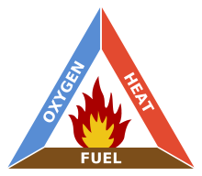
The Fire Triangle –
A Recipe for Fire in Every OR^{13,30}
OXYGEN + FUEL + HEAT = FIRE^{13,30}
Notes:
Surgical Fire Triangle
Fires need three components to begin: Ignition source, fuel source and oxidizer

Slide 12
The Fire Triangle –
A Recipe for Fire in Every OR^{13,30}
Modern OR Preferences Create a Dangerous Fire Triangle
OXYGEN (in already O2–rich OR^{23,31})
  Increased open O2 delivery^{1,31} greater risk than closed delivery (FDA)³⁰
  81% of fires occur when Monitored Anesthesia Care³² (MAC) used^{26,31}
  supplemental O2 usage involved in most OR fires (FDA)²²
FUEL – All surgical preps must contain hydrocarbons.
Hydrocarbons³³ (e.g. isopropyl alcohol) highly flammable
HEAT- ESUs used in 80% or more of all surgical procedures³⁴
OXYGEN-Rich OR²² + Hydrocarbons (FUEL) + ESU Spark (HEAT) = FIRE
Notes:
MAC = Monitored Anesthesia Care, Repeated careful evaluation of a patient's airway, breathing, blood pressure, and organ perfusion during deep sedation or general anesthesia.³²
Hydrocarbons = an organic compound (as acetylene or butane) containing only carbon and hydrogen, highly flammable³³
ESU = Electrosurgical Unit, referring to ESU, cautery, laser, etc. using electricity to causer thermal tissue destruction for dehydration, coagulation or vaporization. Electrosurgical units also referred to as diathermy, energy based devices and different than cautery (passive heat transfer). May want to explain.⁹
*Often electrosurgical devices, including electrocautery, are used interchangeably. Although distinct, every effort is made in the presentation to distinguish electrocautery devices from high-frequency electrosurgery, wherever, distinct mention has been made to electrocautery. Despite this, both have been noted in recent literature to be ignition sources in 90% of OR fires.

Slide 13
The Fire Triangle
The Fire Triangle – A Closer Look at its Dangers
OXYGEN + FUEL + HEAT = FIRE (in final PPT highlight OXYGEN in red)
OR’s create localized oxygen-rich environments²²
Oxygen and nitrous oxide enhance combustion^{10,30}
  OR ambient air with < 21% oxygen (found in normal room air) can support combustion^{24,35}
Methane is encountered routinely during colonoscopies: combustable³⁶
  ignites at only 5%-7% oxygen level found in colon³⁶⁻³⁷
Notes:
Combustion = rapid chemical combination of substance with oxygen, involving heat and light, process of burning something³⁶

Slide 14
Surgical Fire Triangle
The Fire Triangle – A Closer Look at its Dangers
OXYGEN + FUEL + HEAT = FIRE (in final PPT highlight FUEL in red)
FUEL
Hydrocarbon (alcohol-based) skin preps CDC-preferred disinfectants, most commonly used worldwide⁹
  Highly flammable and explosive^{22,27}
  85% of all surgical fires directly related to skin prep!²
  Up to 1-hour dry times¹⁰; difficult to determine when fully dry
Flame resistant, synthetic surgical drapes can catch fire, melt, fuse to skin; add to adverse effects^{7,35}
Notes:
CDC = Centers for Disease Control
Recommended dry times (3 minutes to hairless skin, 1 hour to hairy skin)¹⁰ which is impossible in OR

Slide 15
Hydrocarbon-based³³ surgical preps
FUEL 85% of all surgical fires^{38*}
*National Reporting and Learning Service Database
at National Patient Safety Agency, March 2004-2011.
Notes:
Hydrocarbon = a substance that contains only carbon and hydrogen³³
Source: National Reporting and Learning Service (NRLS) database at the National Patient Safety Agency and reported fires between March 2004-March 2011.
13 reports of fires during a surgical procedure. Of these, 11 were directly related to alcohol-based surgical preps.³⁸
Calculation: 11/13 = 85%

Slide 16
ESUs/electrocautery provide HEAT that sparks 90% of all surgical fires^{8,31}
Notes:
ESU = Electrosurgical Unit, referring to ESU, cautery, laser, etc. using electricity to causer thermal tissue destruction for dehydration, coagulation or vaporization. Electrosurgical units also referred to as diathermy, energy based devices and different than cautery (passive heat transfer).⁹
*Often electrosurgical devices, including electrocautery, are used interchangeably. Although distinct, every effort is made in the presentation to distinguish electrocautery devices from high-frequency electrosurgery, wherever, distinct mention has been made to electrocautery.
Despite this, both have been noted in recent literature to be ignition sources in 90% of OR fires.

Slide 17
Fact: Surgical environments also vary
by patient,
by surgeon,
by procedure,
by anesthesia.

Slide 18
The Painful Consequences of
Surgical Fires
Show burn victims montage on this slide – Teresa pull and put names and year in captions?

Slide 19
  Fact: PERFECT
  surgical education and training,
  pre/intra-operative communications,
  and
  surgical skills will reduce, but
  not eliminate surgical fire risk!

Slide 20
Current Preventative Measures Ineffective
No Required Surgical Fire Training, Drills and OR Practices
No Required, National Mandate⁷; FDA, others only offer OR fire safety recommendations^{7,11,24}
  In 2008 < 50% of U.S. hospitals conducted OR fire safety drills¹²
  1 in 5 U.S. hospitals don’t comply with Never Events* Best Practices (Leapfrog survey, n=1,750)³⁹
Annual training can’t keep pace with technological advances²²
Hospital budgetary and efficiency focus eliminates safety redundancies, gives precedence to competing training needs²²
Fire safety programs, drills and simulations often:
  Exclude relevant, multidisciplinary personnel²², including anesthesia, surgeons²³
  50% of all safety awareness programs excluded OR staff (Ochsner Journal Survey)²³
Usage of fire safety in surgical timeouts and checklists inconsistent⁷
* Never Events = serious adverse and costly events that should never happen when providing medical care^{24,29}
Notes:
Never events = Medical error events that never should happen
Leapfrog is a 16-year old organization that advocates for Medical safety and quality³⁹

Slide 21
Current Preventative Measures Ineffective
No Required ESU Training and Education
Traditional medical curriculum excludes device use education and training⁵
ESU training not required before use^{1,8,25,40}
  Most surgeons get ESU training from industry reps⁵, observing other surgeons⁵ or industry-sponsored courses⁸
In 2014, FUSE became first formal, but optional, curriculum for safe ESU use⁵⁻⁶
  As of January 2017, only 400 practicing surgeons, had completed course⁴¹
A 2011 SAGES survey (n=48), asked experienced surgeons about electrosurgical devices they used daily.
    Median correct response rate was 59% (same for junior surgical residents)^{5,8,40}
    31% did not know how to handle surgical fires^{5,8,40}
    Zero gynecological surgeons passed⁵
    Few surgeons considered themselves experts on devices they used every day⁸
  An Irish survey (n= 63 surgeons) showed:⁴²
    89% of surgeons deemed ESUs safe; 56% had insufficient safe usage knowledge
    82% had no formal ESU training
    49% had personal experience with ESU complications
*FUSE = Fundamental Use of Surgical Energy
**SAGES = The Society of American Gastrointestinal and Endoscopic Surgeons
Notes:
FUSE = Fundamental Use of Surgical Energy⁵
SAGES = The Society of American Gastrointestinal and Endoscopic Surgeons⁵

Slide 22
Fact: Technology is required to help prevent surgical fires, because no current preventative measures can overcome the most basic problem.

Slide 23
Costs to Device Manufacturers, OEMs⁴³, Hospitals and ASC’s⁴⁴
ESU/Electrocautery Malpractice Claims Rising
In 2016, electrosurgical related injuries one of most common causes of malpractice litigation⁴²
Surgical fire plaintiffs more often received monetary awards (78%), versus non-fire claims (51%)^{31*}
Median surgical fire-related claim payment = $120,166^{31*}
*ASA Closed Claims Project, 1990-2009, n=5,194 Total Project, n=103 fire claims³¹
Notes:
OEM = Original Equipment Manufacturer, company whose goods are used as components in the products of another company, who sells the finished item to end users. The company sold to is the reseller who often requests specific designs, etc. before putting together the finished product.⁴³
ASC = Ambulatory Surgical Center, a medical facility designed and equipped to handle surgery, pain management, and certain diagnostic procedures that don't require overnight hospitalization.⁴⁴

Slide 24
Costs to Device Manufacturers, OEMs⁴³, Hospitals and ASC’s⁴⁴
Cost-Benefit Analysis
1 Sparkoff device costs = $x.
Medical device companies, OEMs, hospitals and ASCs could purchase X Sparkoffs for just 1 malpractice payout!
Furthermore, there are staggering non-malpractice costs from surgical fires.
Notes:
OEM = Original Equipment Manufacturer, company whose goods are used as components in the products of another company, who sells the finished item to end users. The company sold to is the reseller who often requests specific designs, etc. before putting together the finished product.⁴³
ASC = Ambulatory Surgical Center, a medical facility designed and equipped to handle surgery, pain management, and certain diagnostic procedures that don't require overnight hospitalization.⁴⁴

Slide 25
Fire Incident Costs to
Hospitals and ASC’s
Extra and Extended Hospital Stays Add Up
Safety lapses caused 2.4 billion extra hospital stays, $17-29 billion excess hospital costs/yr²⁸*
Surviving burn patients incur return OR visits, stays for infections, reconstructive surgeries, etc.²⁶
Medicare/Medicaid/Health Plans Hurt
Medicare program incurs costs to treat consequences from surgical fires³⁹
Medicare and Medicaid assess fines²²
Medicare, some health plans stopped paying hospitals higher reimbursements if surgical fire occured³⁹
Other Fire-Related Costs²²
Loss of Accreditation Status
Damaged Reputation
Psychological impacts on surgical team members involved
*Joint Commission Journal on Quality and Patient Safety, 2015
Remember the Idiom: Penny Wise, Pound Foolish?
Notes:
ASC = Ambulatory Surgical Center, a medical facility designed and equipped to handle surgery, pain management, and certain diagnostic procedures that don't require overnight hospitalization.⁴⁴

Slide 26
Fact: Sparkoff is the only
FDA-approved, OR-ready, patent-protected
surgical device
that fulfills the critical,
unmet market need to
enhance value
AND
minimize surgical fire risk.

Slide 27
Sparkoff Minimizes Surgical Fire Risk
Advanced Gas Sensing, Power Interruption/Restoration and Continuous Aspiration Function
Sparkoff’s proven MEMS⁴⁵ sensors eliminate variability by
  Quickly and precisely gathering and processing real time fire-risks
  sampling surgical fields at a rate of 1500x/second
  Instantaneously detecting and responding to combustible gas particles at the molecular level
  Functions at the exact point of ESU energy discharge
Power to ESU automatically interrupted if explodable gas threat detected
Automatically powers on when fire threat eliminated by Sparkoff’s continuous aspiration function
Notes:
MEMS = Micro-Electro-Mechanical Systems, miniaturized mechanical and electro-mechanical elements (i.e., devices and structures) that are made using the techniques of microfabrication.⁴⁵

Slide 28
With surgical fires, every second counts.³¹
Why does Sparkoff’s functioning speed of 1500x/second matter?
Notes:
ASA = American Society of Anesthesiologists
ASA Closed Claims Project evaluated closed claims from 35 U.S. Liability Insurance Companies over 12-year span
Does NOT include data on TOTAL number of OR fires (numerator) or total number of anesthetics performed (denominator) from 1990-2009 so estimated incidence/risks of fire can’t be provided. Furthermore, this study does not include ALL U.S. insurance carriers so cannot report on all OR-fire related claims³¹

Slide 29
Fact: Sparkoff functions so rapidly that surgeons are not aware of Sparkoff’s enhanced fire prevention capability!

Slide 30
Sparkoff is Easily and Widely Adaptable
Integrates seamlessly with existing ESU generators without altering generator’s footprint
Compatible with all existing electrocautery generators, handpieces and OR vacuum hoses
  Plugs into to existing ESU generator and handpiece; includes gas sensing vacuum hose
  Technology is scalable; portable and fully encapsulated MEMS eliminate expensive packaging⁴⁶⁻⁴⁷
Notes:
MEMS = Micro-Electro-Mechanical Systems, miniaturized mechanical and electro-mechanical elements (i.e., devices and structures) that are made using the techniques of microfabrication.⁴⁵
MEMS require special packaging unless sold to OEMS

Slide 31
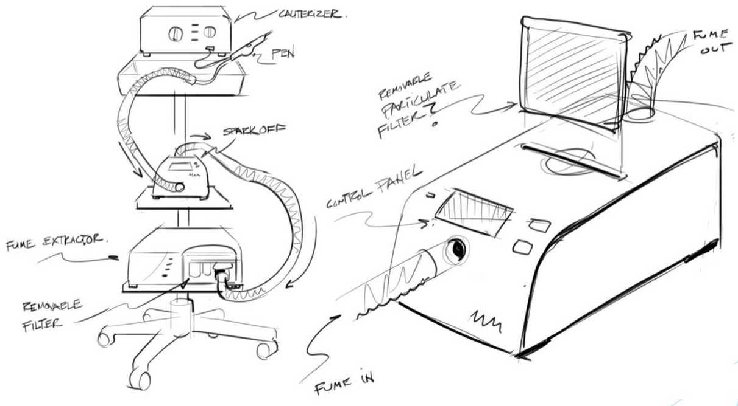
Sparkoff is Easily and Widely Adaptable

Slide 32
Sparkoff Creates a Safer, More Efficient OR
Sparkoff’s automatic continuous aspiration:
  Relieves surgical assistants from manual aspiration for increased OR efficiency
  Eliminates staff exposure to toxic substances⁴⁸
    Spending 1 full day in OR equivalent to smoking
    1 pack of cigarettes a day!⁴⁸

Slide 33
Market Size
  United States
  Registered Hospitals
      5,686 (2015)⁴⁹ , 6 OR suites each on average (2011)⁵⁰ , X cases per room/per day avg.
      5,686 hospitals x 6 ORs/hospital = 34,116 generators
      Total hospital surgeries/day on average = X
    Medicare-certified ASCs (2015)
      5,464 (2015)⁴⁹, 4 OR suites each on average (2015)⁵¹, 3 cases per room/per day avg.⁵²
      5,464 hospitals x 4 ORs/ASC = 21,856 generators
      Total ASC surgeries/day on average = 65,568
    Total hospital and ASC surgeries/day on average = X
    Total average generators in US hospitals and ASC= 55,972*
    * Sparkoff – Generator Ratio 1:1. US average only; No offices included. Does not factor all the 312.9 million global surgeries/yr^{15.}
  Added Revenue Potential - Disposables
  Disposable medical sensor market, projected to near $7 billion in 2019⁵³
  Electrosurgical accessories, 53% of 2015 global ESU market, will exhibit 6.9% CAGR 2016 to 2024 driven by technical innovations, new products and disposables.⁵⁴
  Sparkoff connectors adaptable to proprietary disposable handpieces
Notes:
Average cases per room per day in ASC is 2.12-3.8 (2015)^{52,} which eguates to 2.96 or about 3
Total Hospital computation: 5,686 x 6 = 34,116 x X = XX,XXX Hospital surgeries/day in US
Totals ASC computation: 5,464 x 4 = 21,856 x 3 = 65,568 ASC surgeries/day in US
Total Hospital and ASC Surgeries/Day in US (average) = 65,568 + X

Slide 34
Competition
No Direct Competitors; only soft approaches to fires
  Education, Training and Checklists

Slide 35
Sparkoff – A Protected,
FDA-Approved Technology
2 Active Patents Held for Investment Protection
  device patent
  method patent
FDA 510K approval
Notes:
510-K approval = a new device exhibits roughly the same safety and effectiveness characteristics as its “predicate” device. Successful 510-K clearance results in FDA permission to market the new device.

Slide 36
Why you?
Personalize slide with investor-specific website quotes, mission, etc. (and show source on page) laid out in cool, creative fonts, spacing, etc.)
YOUR mission, YOUR goals talk to bruce about how to position this best for a device company
Integrity
Deliver exactly what you need
Enhanced safety, reliability, performance
Committed to improving lives through medical technologies and solutions
Achieve the best outcomes
Think differently and deliver better health
Practical Innovation
Breakthrough products
Customer satisfaction
Always kind and true
OUR product puts YOUR words to action.

Slide 37
Sparkoff.
Today’s solution for enhancing value
and minimizing surgical fire risk.

Slide 38
Questions?

Slide 39
Bibliography
Jones, D.B., et. al. Safe energy use in the operating room. Current Problems in Surgery, 52, 447-468.
AORN (2017) About AORN. Retrieved April 21, 2017, from https://www.aorn.org/about-aorn
Transparency Market Research. (November 15, 2016) Electrosurgical Devices Market (Product Tuype – Radiofrequency Electrosurgery Devices (Monopolar and Bipolar). Electrocautery Devices (Monopolar and Bipolar), and Electrosurgical Accessories; Application – General Surgery, Gynecology, Cardiology, Urology, Dermatology and Cosmetology, Orthopedics, Neurology, Oncology, Dentistry, and Gastrointestinal Surgery; End User – Hospitals, Ambulatory Surgery Centers, and Specialized Clinics) – Global Industry Analysis, Size, Share, Growth, Trends, and Forecast 2016-2024. Retrieved February 13, 2017, from http://www.transparencymarketresearch.com/electrosurgical-devices-market.html
BusinessWire by Berkshire Hathaway. (March 14, 2017) Global Electrosurgical Devices Market (2016-2022) – By End User, Application & Region – Increasing Demand for Minimally Invasive Surgeries – Research and Markets. Retrieved April 11, 2017, from http://www.businesswire.com/news/home/20170314006228/en/Global-Electrosurgical-Devices-Market-2016-2022---User
Fuchshuber, P., et. al. (July 2015) Fundamental Use of Surgical Energy (FUSE) – Closing a Gap in Medical Education. Ann Surg, 262:1, 20-22.
Fuchshuber, P. (December 29, 2015) FUSE: A Surgeon’s Guide To Understanding Energy Devices. General Surgery News. Retrieved April 11, 2017, from http://www.fuseprogram.org/wp-content/uploads/2016/04/www.generalsurgerynews.pdf
Coletto, K. (August 21, 2016) Anesthesia Providers’ Knowledge and Attitudes on Fire Risk Assessment During Time-out in the Operating Room, Paper 156. Retrieved April 12, 2017, from DePaul University College of Science and Health Theses and Dissertations, http://via.library.depaul.edu/cgi/viewcontent.cgi?article=1164&context=csh_etd
Fuchshuber, P., MD, PhD, FACS, et. al. (2013) Ensuring Safety in the Operating Room – The “Fundamental Use of Surgical Energy” (FUSE) Program. Int Anesthesiol Clin., 51:4, 65-80.
Bovie Medical (November 25, 2014) What Are Energy Based Devices? Retrieved February 10, 2017, from http://blog.boviemed.com/blog-1/what-are-energy-based-devices?
Sibia, U., et. al. (November 2016) Potential Operating Room Fire Hazard of Bone Cement. Am J Orthop, 45:7, E512-E514.
Johnson, T. R.,Ph.D., et. al. The Role of Patient Safety in the Device Purchasing Process. Advances in Patient Safety, 1, 341-351. Retrieved April 12, 2017, from https://www.ncbi.nlm.nih.gov/books/NBK20471/
Aleccia, J. (September 25, 2008) On fire in the OR: Hundreds are hurt every year. Retrieved February 10, 2017, from http://www.nbcnews.com/id/26874567/ns/health-health_care/t/fire-or-hundreds-are-hurt-every-year/#.WO5FclKZPzU
The Joint Commission. (June 24, 2003) Sentinel Event Alert Preventing Surgical Fires, Issue 29. Retrieved April 12, 2017, from https://www.jointcommission.org/assets/1/18/SEA_29.PDF
Centers for Disease Control and Prevention (CDC), (July 6, 2016) Hospital Utilization (in non-Federal short-stay hospitals). Retrieved February 13, 2017, from https://www.cdc.gov/nchs/fastats/hospital.htm
Weiser, T., et. al. (March 1, 2016) Size and distribution of the global volume of surgery in 2012. Bulletin of the World Health Organization 2016, 94:2012-209F. Retrieved April 12, 2017, from WHO http://www.who.int/bulletin/volumes/94/3/15-159293/en/
Investopedia. Compound Annual Growth Rate-CAGR. Retrieved April 11, 2017, from http://www.investopedia.com/terms/c/cagr.asp
Transparency Market Research (January 6, 2014) Minimally Invasive Surgery Market (Surgical Devices, Monitoring & Visualization Devices, and Endoscopy Devices) – Global Industry Analysis, Size, Share, Growth, Trends and Forecast, 2013-2019. Retrieved February 13, 2017, from http://www.transparencymarketresearch.com/minimally-invasive-surgery-market.html
Zinder, D., MD. (2000) Common myths about electrosurgery. Otololaryngology – Head and Neck Surg, 123:4, 450-455.
Grandview Research, Inc. (March 21, 2017) Electrosurgical Devices Market Size to Reach 7.2 Billion by 2025: Grand View Research, Inc. Retrieved April 11, 2017, from http://www.aboutpharma.com/blog/2017/03/21/electrosurgical-devices-market-size-to-reach-7-2-billion-by-2025-grand-view-research-inc/
American Association of Nurse Anesthetists (2012) Surgical Fires. Retrieved February 10, 2017, from http://www.aana.com/resources2/professionalpractice/Pages/Surgical-Fires.aspx

Slide 40
Bibliography
Food and Drug Administration (FDA), (2017) Preventing Surgical Fires. Retrieved February 10, 2017, from https://www.fda.gov/Drugs/DrugSafety/SafeUseInitiative/PreventingSurgicalFires/default.htm
Association of perioperative Registered Nurses (AORN), (October 2014) Empowering Providers to Eliminate Surgical Fires. AORN Journal, 100:4, 412-428.
Hart, S., MD, et. al. (Spring 2011) Operating Room Fire Safety. The Oschner Journal, 11:1,37-42.
Van Wey, K. (August 23, 2016) Why Surgical Fires in the Operating Room Should Never Happen. Retrieved February 10, 2017, from http://www.vanweylaw.com/surgical-fires-operating-room/
Sobolewski, Craig, MD. (October 1, 2013) Electrosurgery: the newest energy-based devices. Retrieved February 13, 2017, from http://contemporaryobgyn.modernmedicine.com/contemporary-obgyn/content/tags/aesculap/electrosurgery-newest-energy-based-devices
Cowles, C. (2017) Fire safety in the operating room. Retrieved February 10, 2017, from http://www.uptodate.com/contents/fire-safety-in-the-operating-room
Durso, F. (January 1, 2012) Operation Fire Safety. National Fire Protection Association (NFPA) Journal, January/February 2012. Retrieved February 10. 2018, from http://www.nfpa.org/news-and-research/publications/nfpa-journal/2012/january-february-2012/features/operation-fire-safety
Barnet, S. (May 28, 2015) ‘Never event’ and preventable patient harm data: 10 challenges, recommendations. Retrieved February 13, 2017, from http://www.beckershospitalreview.com/quality/never-event-and-preventable-patient-harm-data-10-challenges-recommendations.html
Food and Drug Administration (FDA). (October 22, 2010) FDA-Sponsored Stakeholder Meeting on Surgical Fire Prevention. Retrieved February 13, 2017, from https://www.fda.gov/Drugs/DrugSafety/SafeUseInitiative/ucm239511.htm
Food and Drug Administration (FDA), (December 9, 2011) Consumer Update: FDA and Partners Working to Prevent Surgical Fires. Retrieved February 10, 2017, from https://www.fda.gov/ForConsumers/ConsumerUpdates/ucm282810.htm
Mehta, S., MD, et. al. (May 2013) Operating Room Fires, A Closed Claims Analysis. Anesthesiology, 118:5, 1133-1139.
McGraw-Hill Concise Dictionary of Modern Medicine. (2002) monitored anesthesia care. Retrieved April 11, 2017, from http://medical-dictionary.thefreedictionary.com/Monitored+Anesthesia+Care
Merriam-Webster Dictionary (2017) hydrocarbon. Retrieved April 11, 2017, from https://www.merriam-webster.com/dictionary/hydrocarbon
McCauley, G., and Bovie Medical Corporation (2010) Understanding Electrosurgery. 1-16. Retrieved April 12, 2017, from http://www.quickmedical.com/downloads/aaron_understanding-r2_pr.pdf
Emergency Care Research Institute (ECRI) and The Institute of Safe Medication Practices (ISMP) for the Pennsylvania Patient Safety Authority, (2004) Electrosurgical Units and the Risk of Surgical Fires. PA-PSRS Patient Safety Advisory, 1:3.
Ladas, S., et. al. (October 28, 2007) Colonic gas explosion during therapeutic colonoscopy with electrocautery. World J Gastroenterol, 13:40, 5295-5298.
Shopcross (November 29, 2015) LEL (Lower Explosive Limit) for Calibration Gas. Retrieved April 11, 2017, from https://www.shopcross.com/smart/lel-lower-explosive-limit
Rocos, B. and Donaldson, LJ. (March 2012) Alcohol skin preparation causes surgical fires. Ann R Coll Surg Engl, 94, 87-89.
Castlight Health, Inc. for the Leapfrom Group. (2016) NEVER EVENTS Data by Hospital on Nationally Standardized Metrics. Retrieved February 13, 2017, from http://www.leapfroggroup.org/sites/default/files/Files/Castlight-Leapfrog_Never_Events_Final.pdf

Slide 41
Bibliography
Feldman, Liane, et. al. (October 2012) Surgeons don’t know what they don’t know about the safe use of energy in surgery. Surgical Endoscopy, 26:10, 2735-2739.
Jones, S., MD, et. al. (January 13, 2017) Fundamental Use of Surgical Energy (FUSE): An Essential Educational Program for Operating Room Safety. Perm J, 21:16, 4-8.
McQuail, P.M., et. al. (2016) Diathermy awareness among surgeons-An analysis in Ireland. Annals of Medicine and Surgery, 12, 54-59.
Investopedia. Original Equipment Manufacturer – OEM. Retrieved April 11, 2017, from http://www.investopedia.com/terms/o/oem.asp
(2017) What is an ASC? Retrieved April 21, 2017, from http://www.advancingsurgicalcare.com/whatisanasc
Ciuti, G., et. al. (March 17, 2015) MEMS Sensor Technologies for Human Centred Applications in Healthcare, Physical Activities, Safety and Environmental Sensing: A Review on Research Activities in Italy. Sensors, 15, 6441-6468.
Rouse, M. (January 2017) MEMS (micro-electromechanical systems). Retrieved February 13, 2017, from http://internetofthingsagenda.techtarget.com/definition/micro-electromechanical-systems-MEMS
MEMS & Nanotechnology Exchange. Current Challenges. Retrieved March 2, 2017, from https://www.mems-exchange.org/MEMS/challenges.html
Sadler, D. (January/February 2017) The Real Risks: Surgical Smoke. OR Today, 38-41.
Rechtoris, M. (July 22, 2015) 50 things to know about the ambulatory surgery center industry. Retrieved April 21, 2017, from http://www.beckersasc.com/asc-turnarounds-ideas-to-improve-performance/50-things-to-know-about-the-ambulatory-surgery-center-industry.html
(December 5, 2011) Question: Hospital Statistics. Retrieved April 21, 2017 from https://uclue.com/?xq=5379
Dyrda, L. (March 23, 2015) 42 Statistics on ASC space and rent. Retrieved April 21, 2017, from http://www.beckersasc.com/asc-turnarounds-ideas-to-improve-performance/42-statistics-on-asc-space-and-rent.html
Wood, M. and Rechtoris, M. (September 16, 2015) 110 ASC benchmarks/2015. Retrieved April 21, 2017, from http://www.beckersasc.com/asc-turnarounds-ideas-to-improve-performance/110-asc-benchmarks-2015.html
June 2, 2015) Disposable Medical Sensor Market to Approach $7 Billion in 2019. Retrieved April 21, 2017, from https://www.dicardiology.com/article/disposable-medical-sensor-market-approach-7-billion-2019
Ram. (December 23, 2016) Global Electrosurgical Device Market Analysis And Forecasts, By Product 2024. Health. Retrieved April 21, 2017, from http://planet.infowars.com/health/global-electrosurgical-device-market-analysis-and-forecasts-by-product-2024
MEMS & Sensors Industry Group. What is MEMS? Retrieved February 13, 2017, from http://www.memsindustrygroup.org/?page=WhatIsMEMS&hhSearchTerms=%22is+and+MEMS%22
Fedder, G. (1997) Integrated MEMS in Conventional CMOS. Proc. Of the NSF/ASME Workshop on Tribology Issues and Opportunities ion MEMS, 199.

Slide 42
Addendum
Surgical Fire Claim Data
Enhanced Value Proposition

Slide 43
Surgical Fire Claim Data
ESU/Electrocautery Malpractice Claims Rising
Plaintiffs awarded $600 million from electrosurgical device-related injuries (1999, 18 years ago)¹
As a percentage of all surgical claims, fire-related claims increased from < 1% from 1985-1989 to 4.4% from 2000-2009, a > 5-fold increase⁸ (% does not factor increased surgical volume)
According to the ASA Closed Claims Project, 1990-2009, n=5,194 Total Project, n=103 fire claims:³¹
  Electrocautery fires = 4% of all surgical anesthesia fire claims (2000-2009); more common with MAC
  Electrocautery-related MAC fires increased from 6% of claims in 1985-1989 to 31% of 2000-2009 claims
Notes:
ASA = American Society of Anesthesiologists
ASA Closed Claims Project evaluated closed claims from 35 U.S. Liability Insurance Companies over 12-year span
Does NOT include data on TOTAL number of OR fires (numerator) or total number of anesthetics performed (denominator) from 1990-2009 so estimated incidence/risks of fire can’t be provided. Furthermore, this study does not include ALL U.S. insurance carriers so cannot report on all OR-fire related claims³¹
MAC = Monitored Anesthesia Care, Repeated careful evaluation of a patient's airway, breathing, blood pressure, and organ perfusion during deep sedation or general anesthesia.
Hydrocarbons = an organic compound (as acetylene or butane) containing only carbon and hydrogen, highly flammable

Slide 44
Sparkoff Enhances Value
Scale batch fabrication at low per unit costs^{46,55} make bulk purchasing easier for hospitals using GPOs, and pave way for new product introductions
Reduced BOMs for OEMS increase margins⁵⁵
Sparkoffs MEMS-based device has only one part for reduced inventory carrying costs
Notes:
GPOs= General Purchasing Organizations that handle hospital/ASC purchasing negotiations
OEM = Original Equipment Manufacturer, company whose goods are used as components in the products of another company, who sells the finished item to end users. The company sold to is the reseller who often requests specific designs, etc. before putting together the finished product.
BOMs = Bill of Materials
MEMS = Micro Electrical Mechanical Sensors – speak to the clinical safety of and lack historical data objections
Sparkoff works In the same way MEMS monitor poor visibility, other gasses, etc. but this time with OR fire
MEMS = Micro-Electro-Mechanical Systems, miniaturized mechanical and electro-mechanical elements (i.e., devices and structures) that are made using the techniques of microfabrication.

Slide 45
Sparkoff Enhances Value
Supply chain – MEMs devices compatible with CMOS electronics for faster, repeatable, economical fabrication⁵⁵⁻⁵⁶
Compatibility with CMOS simplifies design cycles⁵⁵
Faster speed-to-market⁵⁵
Lower power consumption than macro-based devices⁵⁵
High product reliability for MEMS devices⁵⁵⁻⁵⁶
Notes:
CMOS = Complementary Metal-Oxide-Semiconductor
MEMS = Micro Electrical Mechanical Sensors – speak to the clinical safety of and lack historical data objections
Sparkoff works In the same way MEMS monitor poor visibility, other gasses, etc. but this time with OR fire
MEMS = Micro-Electro-Mechanical Systems, miniaturized mechanical and electro-mechanical elements (i.e., devices and structures) that are made using the techniques of microfabrication.

